Slide 1
MIT App Inventor
Anusha Bathula

Slide 2
Features
Easy for learners to create mobile apps for Android smart phones
Visually fitting together puzzle piece-shaped "programming blocks"
Web-based
1st quarter of 2012, MIT Center for Mobile Learning launched App Inventor service for general public access

Slide 3
Pre-requisites
Basic operation of Android mobiles and laptops.
A Gmail account.
QR Code reader
Zeal to laugh at mistakes and learn from them.

Slide 4
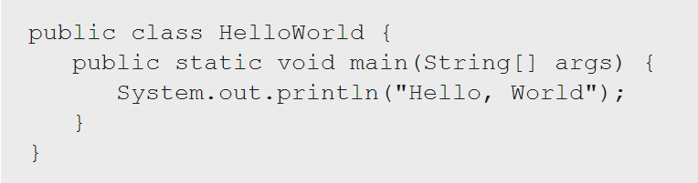
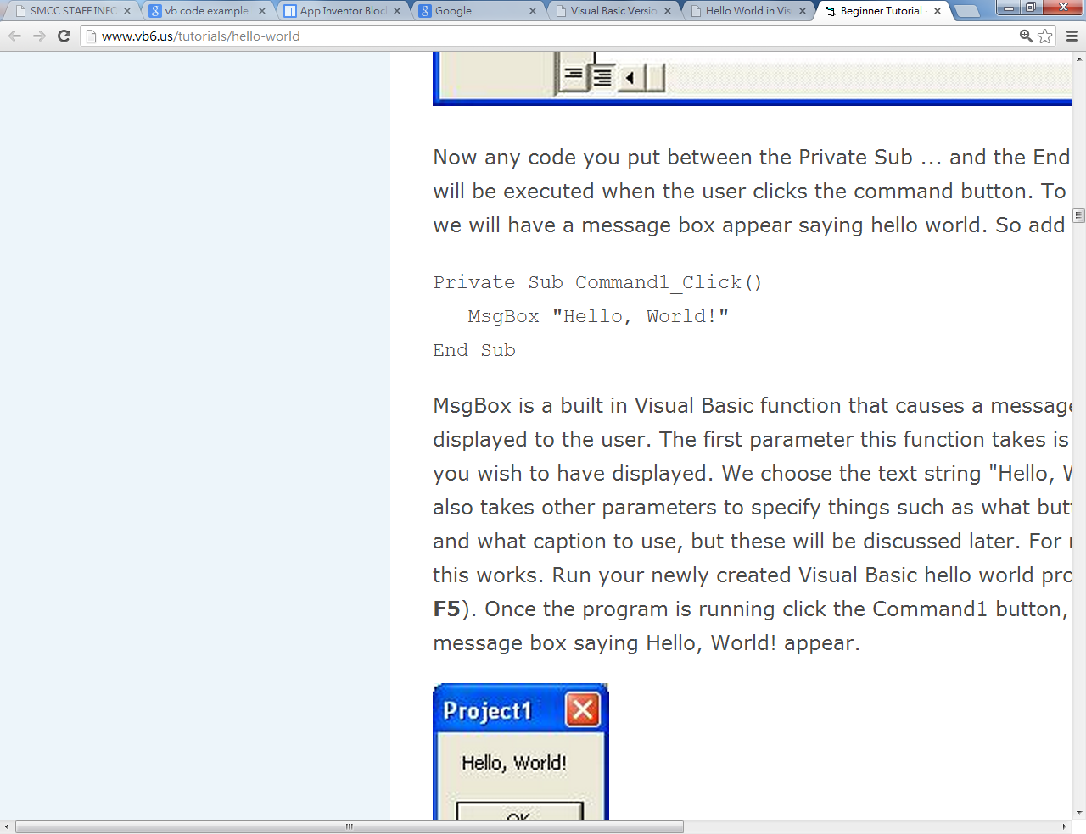
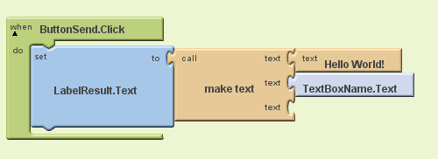
Programming Blocks

Slide 5
Tentative daily content
Day-1:
Gmail Id creation (If not available)
Introduction to ai2.appinventor.mit.edu
Day-2:
Introduction to Apps, components, properties, event Handlers.
App1 creation
Day-3:
App2 Creation
Day-4:
App2 and App3 creation- Covers most of the features in App inventor
Day-5:
Final App presentations

Slide 6
Demo

Slide 7
Q & A

Slide 8
Thank you.

